Slide 1

Data Analysis with
Introduction
& RDDs

Slide 2
What is Apache Spark?
Fast (in-memory), distributed (parallel), general-purpose cluster computing system - spark.apache.org
Open Source project (Apache Software Foundation)
Strongly tied to the Hadoop ecosystem
Data Analysis with Spark - 1. Introduction & RDDs

Slide 3
What is Apache Spark?
Written in Scala → runs in the JVM (Java Virtual Machine)
Pick your language: Scala, Python, R, SQL, Java (not in the notebook environment)
Sparks transforms your code into tasks to run on the cluster nodes
Data Analysis with Spark - 1. Introduction & RDDs

Slide 4
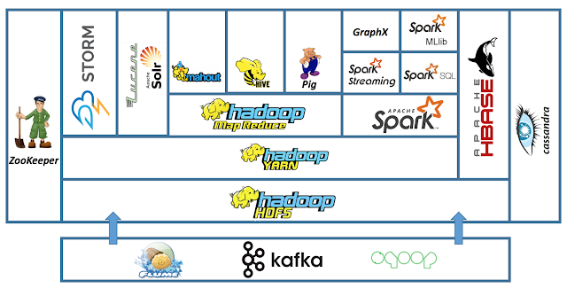
Hadoop Ecosystem
Data Analysis with Spark - 1. Introduction & RDDs

Slide 5
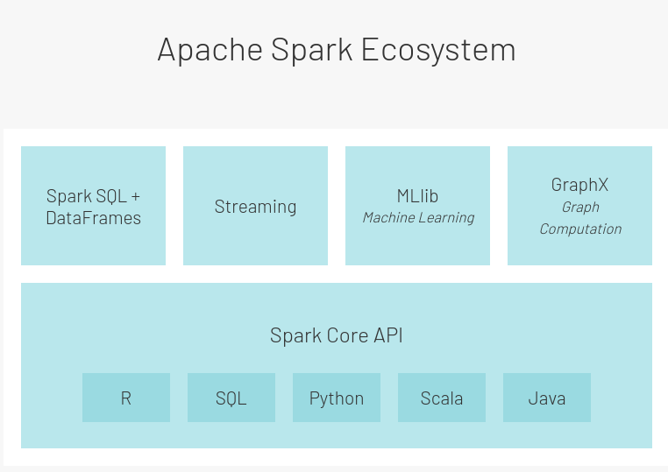
Spark Ecosystem
Data Analysis with Spark - 1. Introduction & RDDs

Slide 6
Use cases
Analyze / transform / apply ML models on:
  Very large datasets (Extract, Transform and Load)
  Streaming data (in near-real-time)
  Graphs (network analysis)
of structured (tables), semi-structured (JSON) or unstructured (text) data
Data Analysis with Spark - 1. Introduction & RDDs

Slide 7
Spark Internals
Spark connects to cluster managers:
  Hadoop YARN
  Apache Mesos
  Kubernetes
  Spark standalone
that distribute resources (RAM, CPU) to applications running on a cluster
Data Analysis with Spark - 1. Introduction & RDDs

Slide 8
Spark Internals
You: Write the code and submit it
Spark:
Asks for resources to create driver + executors
Transforms the code into tasks
Driver sends tasks to executors
Executors sends results to driver
Data Analysis with Spark - 1. Introduction & RDDs

Slide 9


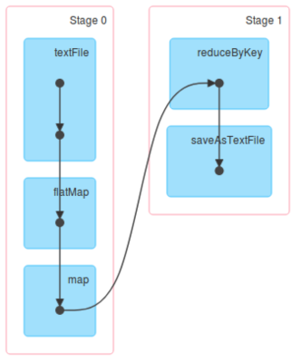
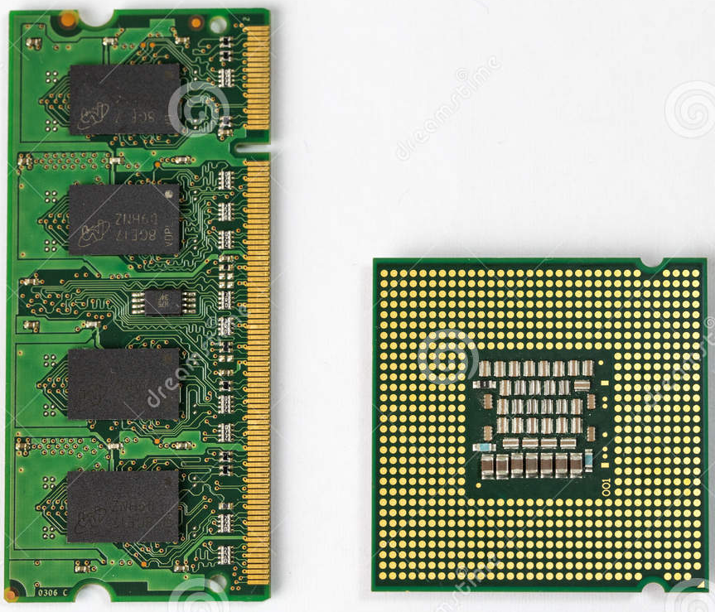
Spark Internals
SparkSession provides a single unified entry point to all of
Spark’s functionality.
SparkSession
Execution plan
Data Analysis with Spark - 1. Introduction & RDDs

Slide 10
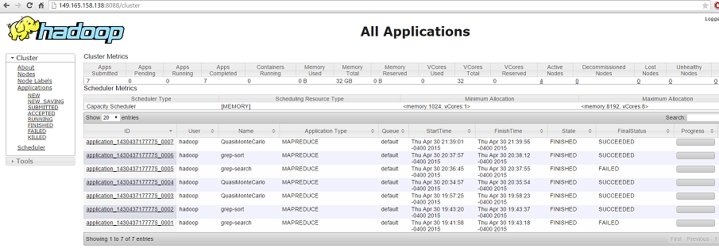
YARN (cluster manager)
Data Analysis with Spark - 1. Introduction & RDDs

Slide 11
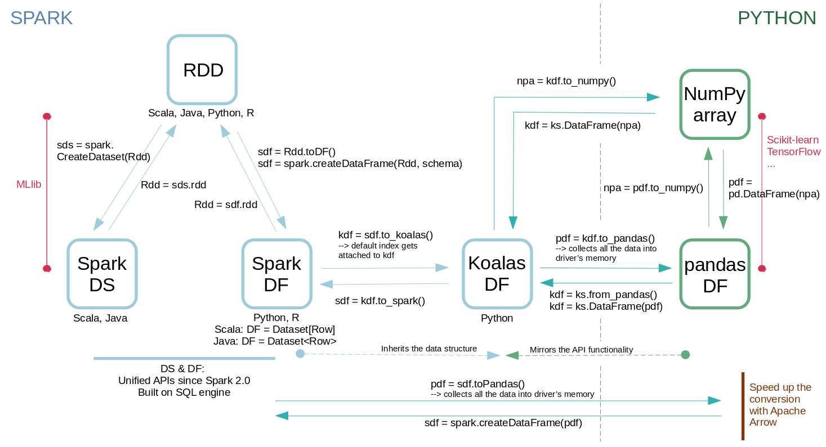
Spark Data Structures
fundamental
Data Analysis with Spark - 1. Introduction & RDDs

Slide 12
Spark Data Structures
fundamental
Data Analysis with Spark - 1. Introduction & RDDs

Slide 13
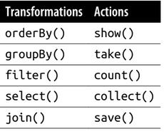
Spark Operations
2 types of operations:
Transformations: transform a Spark DataFrame/RDD into a new DataFrame/RDD without altering the original data
Actions: get the result
Lazy evaluation: transformations triggered when action is called.
Data Analysis with Spark - 1. Introduction & RDDs

Slide 14
RDDs: Resilient Distributed Datasets
A fault-tolerant collection of elements partitioned across the nodes of the cluster (parallelism)
An element can be: string, array, dictionary, etc.
An RDD is immutable
Transformations: lambda expressions on key-value pairs
An RDD can be persisted in memory for reuse (avoid recomputing)
Data Analysis with Spark - 1. Introduction & RDDs

Slide 15
RDDs: Resilient Distributed Datasets
Mostly load data from HDFS (or Hadoop-like file system)
RDDs are partitioned:
  1 partition = 1 block = 128 MB in HDFS
  1 task runs on 1 partition
  Default = 1 partition per CPU core
Data Analysis with Spark - 1. Introduction & RDDs

Slide 16
Spark RDD API
Chain transformations and use the result with an action :
rdd1 = sc.wholeTextFiles(‘hdfs://text/file/path’) \
.map(lambda x: x.split(‘,’)) \
.flatMap(...) \
.groupByKey(...)
rdd1.take(10)
← transformation
← transformation
← transformation
← action
Data Analysis with Spark - 1. Introduction & RDDs

Slide 17
Spark RDD API
When an action is run:
Spark builds a Directed Acyclic Graph (DAG) of stages
1 stage = X tasks (1 by RDD partition)
Tasks are sent to executors
The end of one stage is conditioned by a shuffle
Data Analysis with Spark - 1. Introduction & RDDs

Slide 18
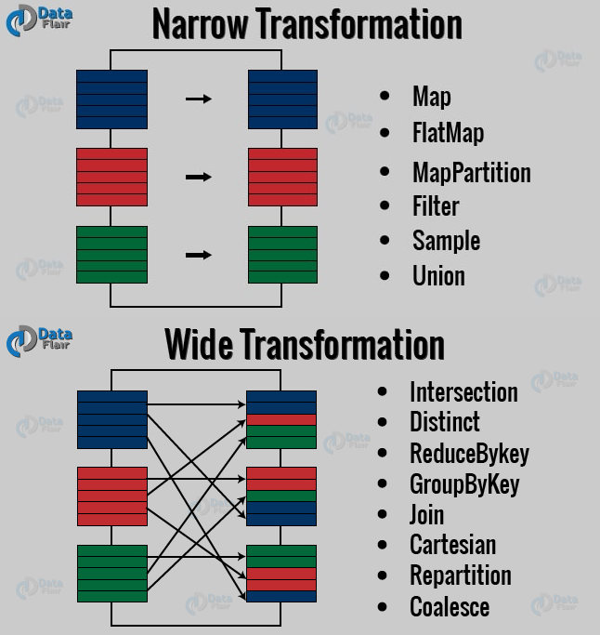
Narrow and Wide Transformations
Data Analysis with Spark - 1. Introduction & RDDs

Slide 19
Spark + RDD: full recap
Spark creates driver + executors
Spark transforms your code into stages (DAG)
Each executor gets partitions of the RDD
For each stage, the driver sends a task to each executor to run on each partition
Some transformations require data shuffling, some don’t
Data Analysis with Spark - 1. Introduction & RDDs

